Slide 1

A JAVA PROJECT
Personal Fitness and Workout Tracker
Presented by
Phanikumar, Madhan and Raghuvansh

Slide 2



Abstract
The Personal Fitness and Workout Tracker is a Java application that helps users record daily workouts, track calories burned, and monitor body metrics such as weight and BMI. Built with core Java constructs, the system stores every session and turns it into simple progress summaries, so users can see how consistent they are and stay motivated toward their fitness goals.
Log workouts
Track calories
View progress

Slide 3

Introduction
Staying fit takes consistency, and consistency is hard to keep without a clear record of what you have done.
This project provides a simple Java-based tool where a user can create a profile, log exercises with duration and calories, and review past sessions at any time.
It applies core Java concepts such as variables, operators, control statements, methods, recursion and arrays.
User profile
Name, age, weight, goal
Workout logging
Exercise, time, calories
Progress review
History and summaries

Slide 4
Existing System
Manual logging
Generic apps
Weak progress view
Notebooks and spreadsheets are easy to forget, hard to search and give no summaries.
Many fitness apps are packed with ads or need paid plans for basic tracking.
Little insight into trends, so users lose motivation and drop their routine.

Slide 5


Proposed System
Profile setup
Add workouts
Calorie tracking
Progress reports
BMI calculator
Workout records
Built with: Java | Scanner | Control Statements | Methods | Arrays

Slide 6
Flowchart
Menu choice?
Start
Enter user details
Show menu, read choice
1. Add workout
2. Calculate BMI
3. View report
4. Exit
Loop back to menu
End

Slide 7
Course Outcome Attainment
CO | Topics covered | How the project attains it
CO1 | Scanner class, output, operators, variables | Scanner reads name, weight and workout details; variables and operators compute calories and BMI; output prints the summary
CO2 | if-else-if, switch, do-while, nested loops, for | do-while menu with switch; if-else-if for BMI category; for and nested loops for the weekly report
CO3 | Methods, recursion, arrays | Methods for add workout, BMI and calories; recursion for total calories; arrays store workout records

Slide 8
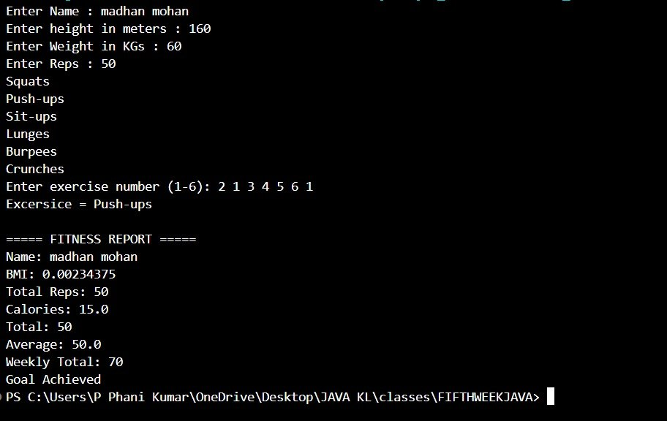
Result Screenshots
Program output

